Slide 1



Slide 2

^{The language we use:} 10 (8) minutes on introspection, feedback and self-awareness
Chris Unwin

Slide 3


Slide 4

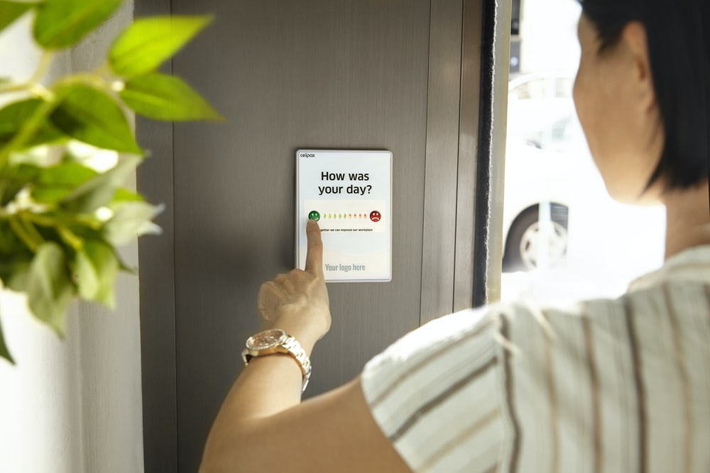

Our Thoughts
Notes:
Images:
https://images.unsplash.com/photo-1508591360875-10163ed98c8e?ixlib=rb-1.2.1&ixid=eyJhcHBfaWQiOjEyMDd9&auto=format&fit=crop&w=675&q=80
https://images.unsplash.com/photo-1589187775328-882e91b3db4f?ixlib=rb-1.2.1&ixid=eyJhcHBfaWQiOjEyMDd9&auto=format&fit=crop&w=1350&q=80
https://images.unsplash.com/photo-1446511437394-36cdff3ae1b3?ixlib=rb-1.2.1&ixid=eyJhcHBfaWQiOjEyMDd9&auto=format&fit=crop&w=1350&q=80

Slide 5

“Good”
Notes:
Images:
https://images.unsplash.com/photo-1489710437720-ebb67ec84dd2?ixlib=rb-1.2.1&ixid=eyJhcHBfaWQiOjEyMDd9&auto=format&fit=crop&w=1350&q=80

Slide 6
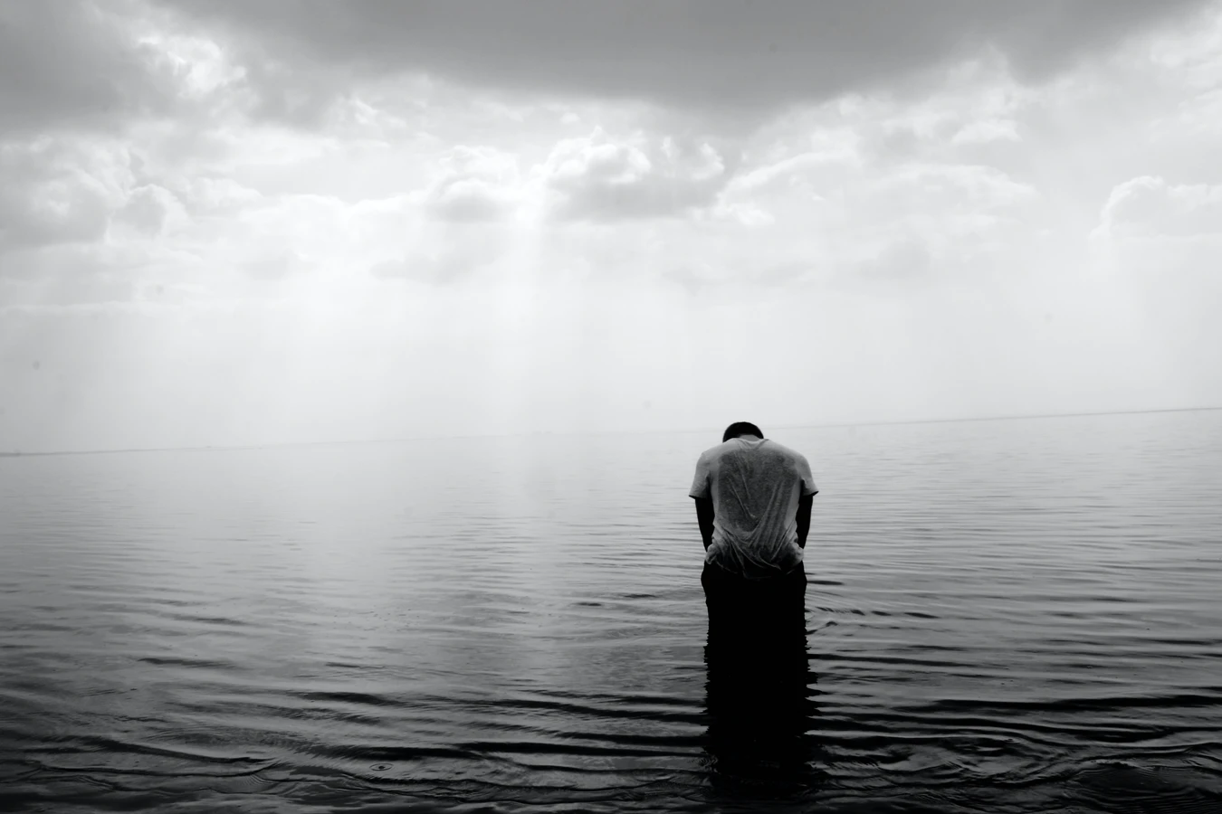
“Bad”
Notes:
Images:
https://images.unsplash.com/reserve/dPfjQTyJSJ2LpM7D9Yr0_Photo%2015-02-2014.jpg?ixlib=rb-1.2.1&ixid=eyJhcHBfaWQiOjEyMDd9&auto=format&fit=crop&w=1350&q=80

Slide 7
“Meh”

Slide 8
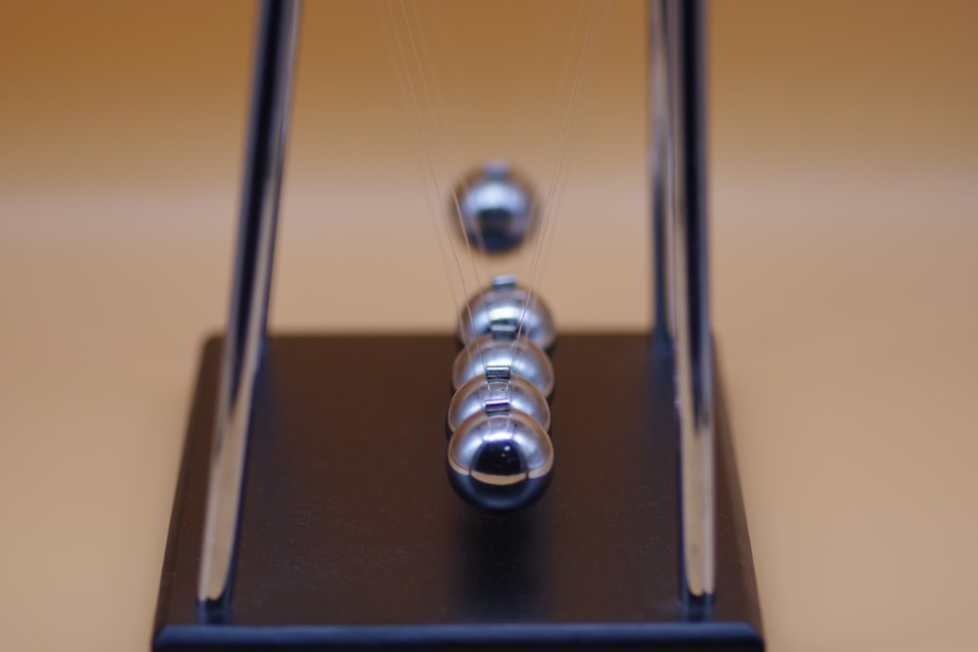
Our thoughts have a profound impact on who we are.
Notes:
Image: https://images.unsplash.com/photo-1588720516255-fc99581c9716?ixlib=rb-1.2.1&ixid=eyJhcHBfaWQiOjEyMDd9&auto=format&fit=crop&w=1350&q=80

Slide 9

#1: Introspection
You are not the product of your thoughts.
Your thoughts are the product of your experiences.
You choose how to experience those thoughts and emotions.
Notes:
Image: https://images.unsplash.com/photo-1531956759688-e71cc2586e34?ixlib=rb-1.2.1&ixid=eyJhcHBfaWQiOjEyMDd9&auto=format&fit=crop&w=634&q=80
Introspection: the process of observing the operations of one’s own mind

Slide 10




Observe.
Acknowledge.
Adjust.
Notes:
Image: https://images.unsplash.com/photo-1543210089-238ae1f26b32?ixlib=rb-1.2.1&ixid=eyJhcHBfaWQiOjEyMDd9&auto=format&fit=crop&w=634&q=80

Slide 11

#2: Self Awareness
Self awareness is not just knowing where you are and what you’re doing
Self awareness is about Monitoring
Understanding our stress, worries, emotions and beliefs
Notes:
Image: https://images.unsplash.com/photo-1531956759688-e71cc2586e34?ixlib=rb-1.2.1&ixid=eyJhcHBfaWQiOjEyMDd9&auto=format&fit=crop&w=634&q=80

Slide 12

Embrace Vulnerability
and Honesty.
Notes:
Image: https://images.unsplash.com/photo-1571266882932-33f7c046a0c9?ixlib=rb-1.2.1&ixid=eyJhcHBfaWQiOjEyMDd9&auto=format&fit=crop&w=634&q=80
Don’t let shame control you.

Slide 13
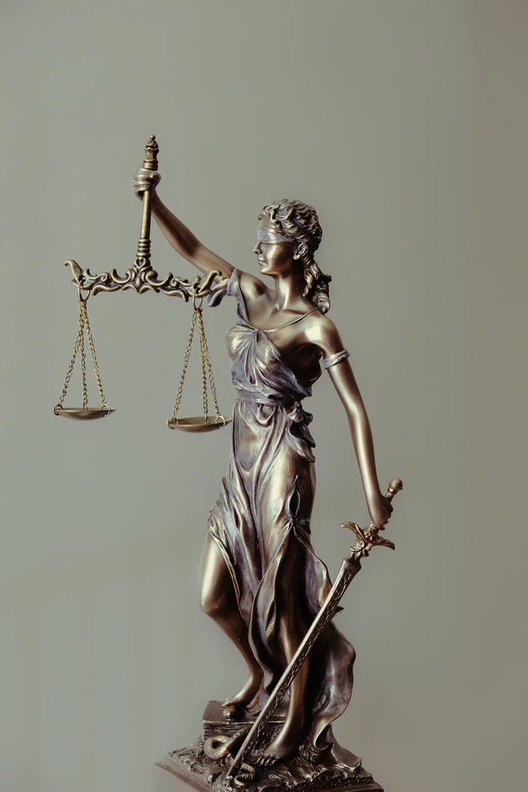
#3: Feedback
We are afraid of judgement
When we speak to or about ourselves we enforce our own judgement
We only self-reflect when things go wrong
Notes:
Image: https://images.unsplash.com/photo-1589578527966-fdac0f44566c?ixlib=rb-1.2.1&ixid=eyJhcHBfaWQiOjEyMDd9&auto=format&fit=crop&w=634&q=80

Slide 14
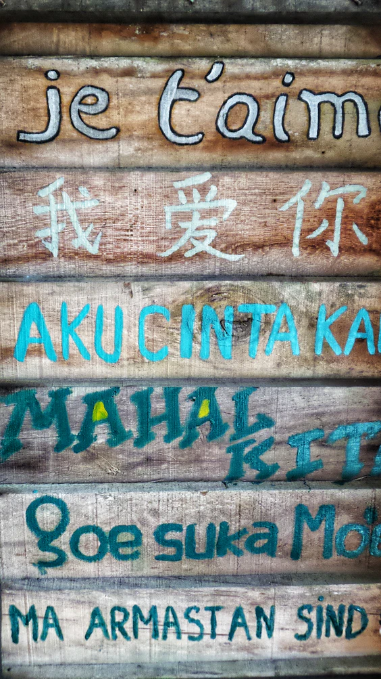
I’ll never be able to do this / I can’t do this
Change up your language.
I will be able to do this, who can I ask for help?
Notes:
Image: https://images.unsplash.com/photo-1571498664957-fde285d79857?ixlib=rb-1.2.1&ixid=eyJhcHBfaWQiOjEyMDd9&auto=format&fit=crop&w=564&q=80

Slide 15

Stop comparing yourself to others.
Everyone is different.
Notes:
Image: https://images.unsplash.com/photo-1571266882932-33f7c046a0c9?ixlib=rb-1.2.1&ixid=eyJhcHBfaWQiOjEyMDd9&auto=format&fit=crop&w=634&q=80

Slide 16

Conclusions
You are the product of your actions, not your thoughts.
Check in with yourself when times are good, not just bad.
If you need help, reach out.
Notes:
Image Source: https://images.unsplash.com/photo-1578357078586-491adf1aa5ba?ixlib=rb-1.2.1&ixid=eyJhcHBfaWQiOjEyMDd9&auto=format&fit=crop&w=700&q=80

Slide 17

Resources
Brene Brown on Vulnerability (YouTube)
Stop Calling Yourself An Idiot (Blog)
Meditate in a Moment (YouTube)
Mindfulness Made Easy (Podcast)
Notes:
Image: https://images.unsplash.com/photo-1589578527966-fdac0f44566c?ixlib=rb-1.2.1&ixid=eyJhcHBfaWQiOjEyMDd9&auto=format&fit=crop&w=634&q=80

Slide 18

Notes:
Image: https://images.unsplash.com/photo-1502355984-b735cb2550ce?ixlib=rb-1.2.1&ixid=eyJhcHBfaWQiOjEyMDd9&auto=format&fit=crop&w=1350&q=80

